Slide 1
Module 6: Application Deployment and Security
Instructor Materials
DevNet Associate v1.0
Notes:
Cisco Networking Academy Program
DevNet Associate v1.0
Module 6: Application Deployment and Security

Slide 2
Instructor Materials – Module 6 Planning Guide
This PowerPoint deck is divided in two parts:
Instructor Planning Guide
Information to help you become familiar with the module
Teaching aids
Instructor Class Presentation
Optional slides that you can use in the classroom
Begins on slide # 9
Note: Remove the Planning Guide from this presentation before sharing with anyone.
For additional help and resources go to the Instructor Home Page and Course Resources for this course. You also can visit the professional development site on www.netacad.com, the official Cisco Networking Academy Facebook page, or Instructor Only FB group.
Notes:
2

Slide 3
What to Expect in this Module
To facilitate learning, the following features may be included in this module:
Feature | Description
Hands-On Labs | Labs designed for working with physical equipment.
Module Quizzes | Self-assessments that integrate concepts and skills learned throughout the series of topics presented in the module.
Module Summary | Briefly recaps module content.

Slide 4
Check Your Understanding
Check Your Understanding activities are designed to let students quickly determine if they understand the content and can proceed, or if they need to review.
Check Your Understanding activities do not affect student grades.
There are no separate slides for these activities in the PPT. They are listed in the notes area of the slide that appears before these activities.
Notes:
4

Slide 5
Module 6: Activities
What activities are associated with this module?
Page # | Activity Type | Activity Name | Optional?
6.2.7 | Lab | Build a Sample Web App in a Docker Container | Recommended
6.3.6 | Lab | Lab – Build a CI/CD Pipeline Using Jenkins | Recommended
6.5.10 | Lab | Lab – Explore the Evolution of Password Methods | Recommended
Notes:
5

Slide 6
Module 6: Best Practices
Prior to teaching Module 6, the instructor should:
Review the activities and assessments for this module.
Try to include as many questions as possible to keep students engaged during classroom presentation.
Topic 6.1
Ask if the learners understand the term deployment choices.
Explain the deployment environments.
Explain the deployment models and ask the learners to share their understanding of the same in the class.
Probe if the learners know about the types of infrastructure.
Reinforce the difference between a private and a public cloud.
Notes:
6

Slide 7
Module 6: Best Practices (Contd.)
Topic 6.2
Ask the learners if they have heard the term "docker" or "dockerfile“. If yes, ask them to share their understanding of the terms.
Discuss the anatomy of a dockerfile.
Explain how you can start a Docker Container locally.
Explain how to save a Docker Image to a Registry.
Topic 6.3
Explain Continuous Integration/Continuous Deployment (CI/CD) and validate the learners’ understanding by asking them to list the benefits of CI/CD.
Ask the learners to share their understanding of Continuous Integration.
Notes:
7

Slide 8
Module 6: Best Practices (Contd.)
Topic 6.4
Ask if the learners know of any applications that can be used for cloud deployment. Ask them to share their knowledge and discuss the same with their peers.
Topic 6.5
Probe the learners’ understanding about software attacks and conduct a discussion on the subject.
Explain the SQL injection technique.
Discuss Cross-Site Scripting, Cross-Site Request Forgery, and the OWASP Top Ten.
Ask if the learners know anything of the evolution of password systems and the techniques used for cracking the passwords.
Notes:
8

Slide 9
Module 6: Application Deployment and Security
DevNet Associate v1.0
Notes:
Cisco Networking Academy Program
DevNet Associate v1.0
Module 6: Application Deployment and Security
In-Session Activities / Explanations:
Time: 5 min
Instructor Notes:
To start the class, build the context by briefing the learners on application deployment and security.
Mention that this module will introduce them to various application deployment options.
Also mention that they will learn about the components of a continuous integration and continuous deployment pipeline, including containers and microservices. Examples of deployment in test environments and in production environments will be showcased during the course of learning and the learners will also learn about deployment security measures and understand known vulnerabilities.
Once the introduction to the module is completed, read out the Objectives and briefly describe each.
Key Points: NA

Slide 10
Module Objectives
Module Title: Application Deployment and Security
Module Objective: Use current technologies to deploy and secure applications and data in a cloud environment.
Topic Title | Topic Objective
Understanding Deployment Choices with Different Models | Explain common cloud deployment models.
Creating and Deploying a Sample Application | Use container technology to deploy a simple application.
Continuous Integration/Continuous Deployment (CI/CD) | Explain the use of Continuous Integration/Continuous Deployment (CI/CD) in application deployment.
Networks for Application Development and Security | Explain the network technology required for application development in a cloud environment.
Securing Applications | Use common application security techniques to secure data.
Notes:
10
DevNet Associate v1.0
6 – Application Deployment and Security
6.0 – Introduction to Application Deployment and Security
6.0.2 – What Will I Learn to Do in this Module?

Slide 11
6.1 Understanding Deployment Choices with Different Models
Notes:
Source:
6 – Application Deployment and Security
6.1 – Understanding Deployment Choices with Different Models
In-Session Activities / Explanations:
Time: 15min
Instructor Notes:
Introduce the topic and explain various deployment environments.
Discuss various deployment models.
Explain the types of infrastructure and On-Premises.
By the end of the topic, ensure the learners also have understanding of different types of clouds.
Key Points:
Development Environment, Testing Environment, Staging Environment, Production Environment
On-Premises, Private, Public, Hybrid, Edge.

Slide 12
Application Deployment and Security Introduction to Deployment Choices
Developers need to do more than deliver application code: they need to concern themselves with how applications are deployed, secured, operated, monitored, scaled, and maintained.
The physical and virtual infrastructure and platforms on which applications are being developed and deployed are quickly evolving.
Developers are confronted with an expanding stack of platform options, which are all hosted on infrastructures and frameworks of increasing flexibility and complexity.
Notes:
6 – Application Deployment and Security
6.1 – Understanding Deployment Choices with Different Models
6.1.1 – Introduction to Deployment Choices

Slide 13
Application Deployment and Security Deployment Environments
A piece of code, before it reaches to the user, passes through a number of environments that leads to an increase in its quality and reliability. These environments are self-contained and mimic the ultimate environment in which the code will live.
Typically, large organizations use a four-tier structure:
Development | Testing | Staging | Production
This environment is used for coding. It is also used to manage fundamental aspects of the infrastructure, such as containers or cloud networking. | This environment is used for testing the code. It should be structurally similar to the final production environment, on a much smaller scale. It often includes automated testing tools as well as integration with a version control system. | This environment is used for final acceptance testing in a realistic environment. After the code has been tested, it moves to the staging environment. | This environment is used for deploying the final code for the end user interaction. It must be sized and constructed to handle expected traffic, including surges that might come seasonally or with a particular event.
Notes:
6 – Application Deployment and Security
6.1 – Understanding Deployment Choices with Different Models
6.1.2 – Deployment Environments

Slide 14
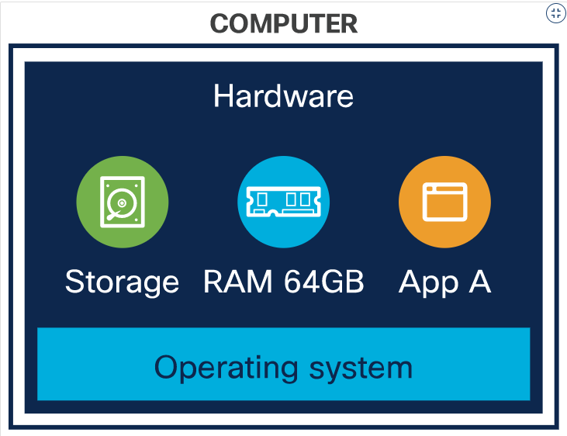
Application Deployment and Security Deployment Models
There are various deployment models that can be used to deploy a software. These include Bare Metal, Virtual Machines, Container-based Infrastructure and Serverless Computing.
Bare Metal
A bare metal deployment is essentially deploying to an actual computer. It is used to install a software directly on the target computer.
In this method, software can directly access the operating system and the hardware.
It is useful for situations requiring access to specialized hardware, or for High Performance Computing (HPC) applications.
It is now used as infrastructure to host virtualization and cloud frameworks.
Notes:
6 – Application Deployment and Security
6.1 – Understanding Deployment Choices with Different Models
6.1.3 – Deployment Models

Slide 15
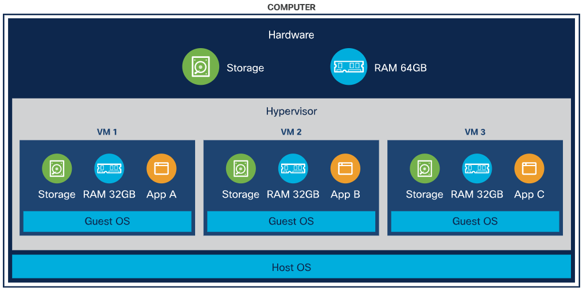
Application Deployment and Security Deployment Models (Contd.)
Virtual Machines (VMs)
Virtual machines share the resources of the host. It is like a computer within the computer and has its own computing power, network interfaces, and storage.
Hypervisor is software that creates and manages VMs.
VMs run on top of a hypervisor that provides VMs with simulated hardware, or with controlled access to underlying physical hardware.
Notes:
6 – Application Deployment and Security
6.1 – Understanding Deployment Choices with Different Models
6.1.3 – Deployment Models

Slide 16
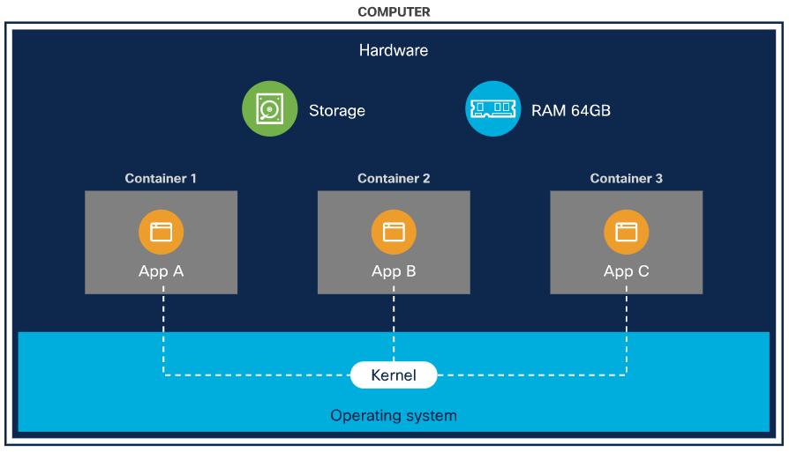
Application Deployment and Security Deployment Models (Contd.)
Container-based infrastructure
Containers were designed to provide the same benefits as VMs, such as workload isolation and the ability to run multiple workloads on a single machine but are designed to start up quickly.
Containers share resources of the host including the kernel.
A container shares the operating system of the host machine and uses container-specific binaries and libraries.
Notes:
6 – Application Deployment and Security
6.1 – Understanding Deployment Choices with Different Models
6.1.3 – Deployment Models

Slide 17
Application Deployment and Security Deployment Models (Contd.)
Serverless Computing
Serverless computing takes advantage of a modern trend towards applications that are built around services. Application makes a call to another program or workload to accomplish a particular task, to create an environment where applications are made available on an “as needed” basis.
It works as follows:
Step 1. The developer creates an application.
Step 2. The developer deploys the application as a container, so that it can run easily in any appropriate environment.
Step 3. The developer deploys that container to a serverless computing provider. This deployment includes a specification of how long the function should remain inactive before it is spun down.
Step 4. When necessary, the application calls the function.
Step 5. The provider spins up an instance of the container, performs the needed task, and returns the result.
Notes:
6 – Application Deployment and Security
6.1 – Understanding Deployment Choices with Different Models
6.1.3 – Deployment Models

Slide 18
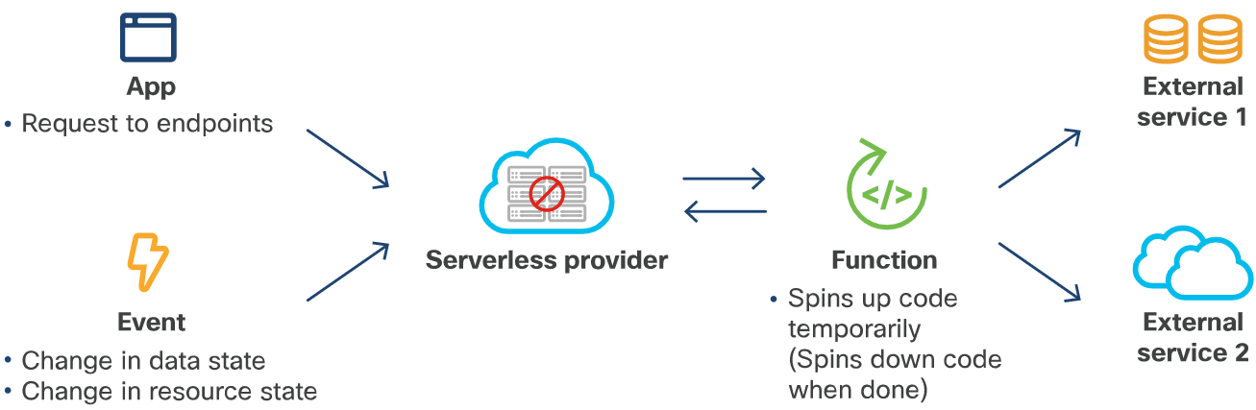
Application Deployment and Security Deployment Models (Contd.)
Serverless computing takes responsibility for assigning resources away from the developer and only incurs costs when the application runs.
Notes:
6 – Application Deployment and Security
6.1 – Understanding Deployment Choices with Different Models
6.1.3 – Deployment Models

Slide 19
Application Deployment and Security Types of Infrastructure
In the early days of computers, infrastructure was pretty straightforward. Software ran on a single computer and networks could link multiple computers together.
Now, infrastructure has become more complicated, with various options available for designing the infrastructure such as different types of clouds, and what each does and does not do well.
Notes:
6 – Application Deployment and Security
6.1 – Understanding Deployment Choices with Different Models
6.1.4 – Types of Infrastructure

Slide 20
Application Deployment and Security On-Premises
On-Premises means any system that is literally within the confines of the building.
On-Premises are the traditional data centers that house individual machines which are provisioned for applications, rather than clouds.
These traditional data centers with servers dedicated to individual applications, or to VMs, which enable a single computer to act like multiple computers.
Operating a traditional on-premises data center requires servers, storage devices, and network equipment to be ordered, received, assembled in racks, moved to a location, cabled for power and data. All this setup of infrastructure takes time and effort.
Problems related to On-Premises can be solved by moving to a cloud-based solution.
Notes:
6 – Application Deployment and Security
6.1 – Understanding Deployment Choices with Different Models
6.1.5 – On-Premises

Slide 21
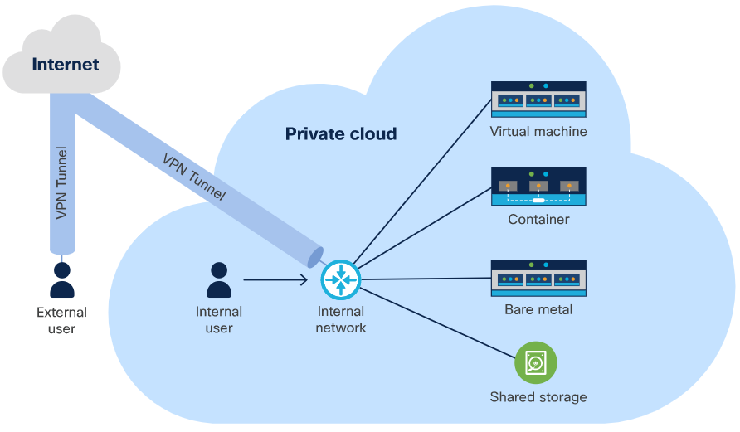
Application Deployment and Security Private Cloud
A cloud is a system that provides self-service provisioning for compute resources, networking, and storage.
In a private cloud infrastructure, the organization controls all of the resources.
In most cases, a private cloud is located in a data center and all resources that run on the hardware belong to the owner organization.
The advantage of a private cloud is that one has complete control over where it is located.
An operations team is required to manage the cloud and keep it running.
Notes:
6 – Application Deployment and Security
6.1 – Understanding Deployment Choices with Different Models
6.1.6 – Private Cloud

Slide 22
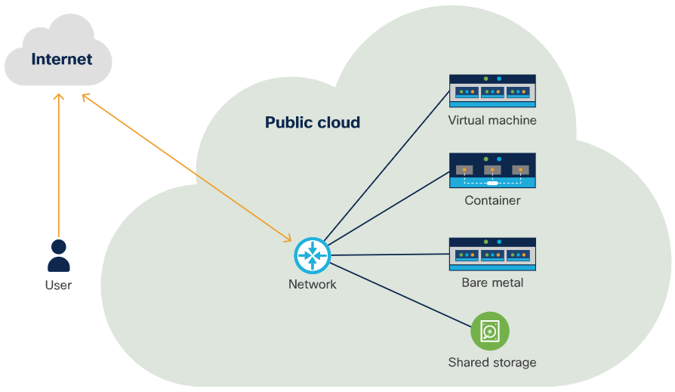
Application Deployment and Security Public Cloud
A public cloud is the same as a private cloud, but it is managed by a public cloud provider.
Public cloud customers may share resources with other organizations. Alternatively, public cloud providers may provide customers with dedicated infrastructure.
With a public cloud, the organization does not control the resources.
A public cloud is helpful in scaling up virtually as long as the load requires and then scale down when traffic is slow.
One disadvantage of public cloud is known as the "noisy neighbor" problem.
Notes:
6 – Application Deployment and Security
6.1 – Understanding Deployment Choices with Different Models
6.1.7 – Public Cloud

Slide 23
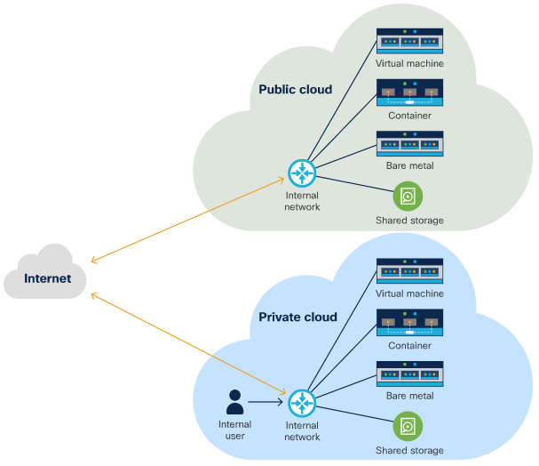
Application Deployment and Security Hybrid Cloud
Hybrid cloud is the combination of two different types of clouds.
Hybrid cloud is used to bridge a private cloud and a public cloud within a single application.
Hybrid cloud combines public and private cloud to provide additional resources and security where necessary.
Hybrid cloud is distinguished by the use of more than one cloud within a single application.
Container orchestrators have become very popular with companies employing hybrid-cloud deployments.
Notes:
6 – Application Deployment and Security
6.1 – Understanding Deployment Choices with Different Models
6.1.8 – Hybrid Cloud

Slide 24
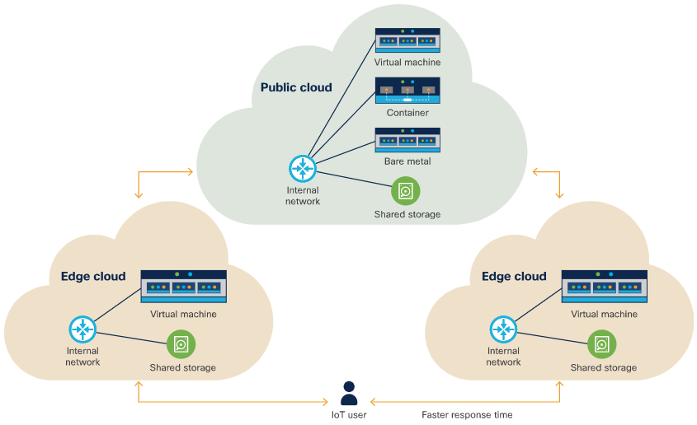
Application Deployment and Security Edge Cloud
Edge cloud is gaining popularity because of the growth of the Internet of Things (IoT).
Edge cloud enables resources to be closer to where they are needed.
Edge cloud computing comprises one or more central clouds that act as a hub for the edge clouds themselves.
Hardware for the edge clouds is located as close as possible to the user.
Edge cloud run on much smaller hardware so they may be more resource-constrained.
Notes:
6 – Application Deployment and Security
6.1 – Understanding Deployment Choices with Different Models
6.1.9 – Edge Cloud

Slide 25
6.2 Creating and Deploying a Sample Application
Notes:
Source:
6 – Application Deployment and Security
6.2 – Creating and Deploying a Sample Application
In-Session Activities / Explanations:
Time: 15 min
Instructor Notes:
Start the topic by introducing the learners to the concept of Docker containers.
Explain different components of a docker file.
Explain the steps to start the docker container locally.
Explain the steps to save a docker image to a registry.
By the end of the topic, encourage the learners to perform the Hands-on Lab.
Key Points: Dockerfile, docker build, docker run, docker commit.

Slide 26
Creating and Deploying a Sample Application What is Docker?
The most popular way to containerize an application is to deploy it as a Docker container. A container is a way of encapsulating everything you need to run your application, so that it can easily be deployed in a variety of environments. Docker is a way of creating and running that container.
Docker is a format that wraps a number of different technologies to create containers. These technologies are:
Namespaces - These isolate different parts of the running container.
Control groups - These cgroups are a standard Linux concept that enables the system to limit the resources, used by an application.
Union File Systems - These UnionFS are file systems that are built layer by layer, combining resources.
A Docker image is a set of read-only files that have no state and contains source code, libraries, and other dependencies needed to run an application.
A Docker container is the run-time instance of a Docker image.
Creating a container involves pulling an image or a template from a repository, then using it to create a container.
Notes:
6 – Application Deployment and Security
6.2 – Creating and Deploying a Sample Application
6.2.1 – What is Docker?

Slide 27
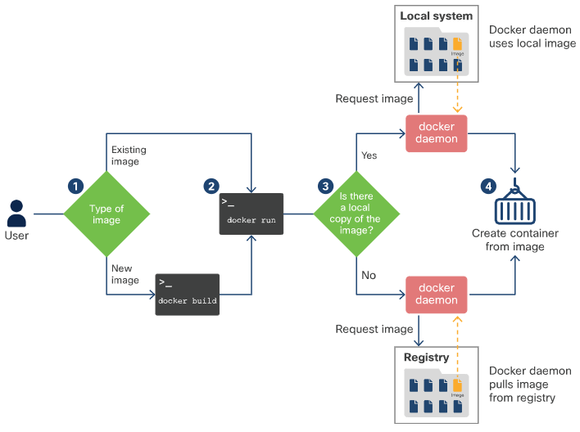
Creating and Deploying a Sample Application What is Docker? (Contd.)
The workflow of creating a container is as follows:
Step 1: Either create a new image using docker build or pull a copy of an existing image from a registry using docker pull.
Step 2: Run a container based on the image using docker run or docker container create.
Step 3: The Docker daemon checks to see if it has a local copy of the image. If it does not, it pulls the image from the registry.
Step 4: The Docker daemon creates a container based on the image and, if docker run was used, logs into it and executes the requested command.
Notes:
6 – Application Deployment and Security
6.2 – Creating and Deploying a Sample Application
6.2.1 – What is Docker?

Slide 28
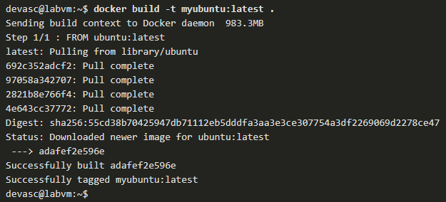
Creating and Deploying a Sample Application What is a Dockerfile?
Dockerfile is a simple text-file which is required to compile the code.
It defines the steps that the docker build command takes to create an image that can be used to create the target container.
Steps to generate a Dockerfile that creates an Ubuntu container:
Create a file named Dockerfile and save it in the current directory.
Run the docker build command to build the image using a Dockerfile in the current directory (.) and give it a name of myubuntu.
Notes:
6 – Application Deployment and Security
6.2 – Creating and Deploying a Sample Application
6.2.2 – What is Dockerfile?

Slide 29
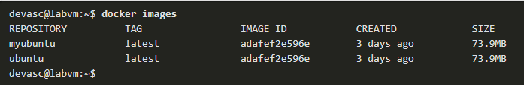
Creating and Deploying a Sample Application What is a Dockerfile? (Contd.)
Enter the command docker images to see your image in the list of images on the DEVASC VM.
Change to the home directory and enter Is to see that it is empty and ready for use.
Enter exit to leave the Docker container and return to your DEVASC VM main operating system.
Notes:
6 – Application Deployment and Security
6.2 – Creating and Deploying a Sample Application
6.2.2 – What is Dockerfile?

Slide 30
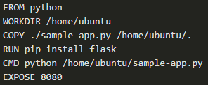
Creating and Deploying a Sample Application Anatomy of a Dockerfile
Consider the following Dockerfile that containerizes a Python app and the explanation of the commands are as follows:
The FROM command installs Python in the Docker image.
The WORKDIR command tells Docker to use /home/ubuntu as the working directory.
The COPY command tells Docker to copy the file from Dockerfile’s current directory into /home/ubuntu.
The RUN command allows to directly run commands on the container.
The CMD command will start the server when the user run the actual container.
The EXPOSE command tells Docker that the user want to expose port 8080.
Notes:
6 – Application Deployment and Security
6.2 – Creating and Deploying a Sample Application
6.2.3 – Anatomy of a Dockerfile

Slide 31
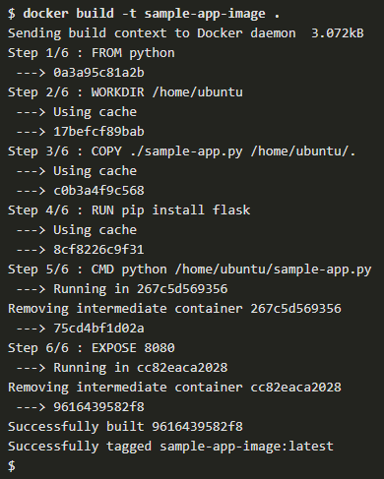
Creating and Deploying a Sample Application
Anatomy of a Dockerfile (Contd.)
Docker takes advantage of what is stored in cache to speed up the process.
The docker build command is used to build the image. In the given output, the image was previously built.
The Docker goes through each step in the Dockerfile, starting with the base image, Python. If this image does not exist on the system, Docker pulls it from the registry. The default registry is Docker Hub.
Between steps such as executing a command, Docker actually creates a new container and builds an intermediate image, a new layer, by saving that container.
Notes:
6 – Application Deployment and Security
6.2 – Creating and Deploying a Sample Application
6.2.3 – Anatomy of a Dockerfile

Slide 32
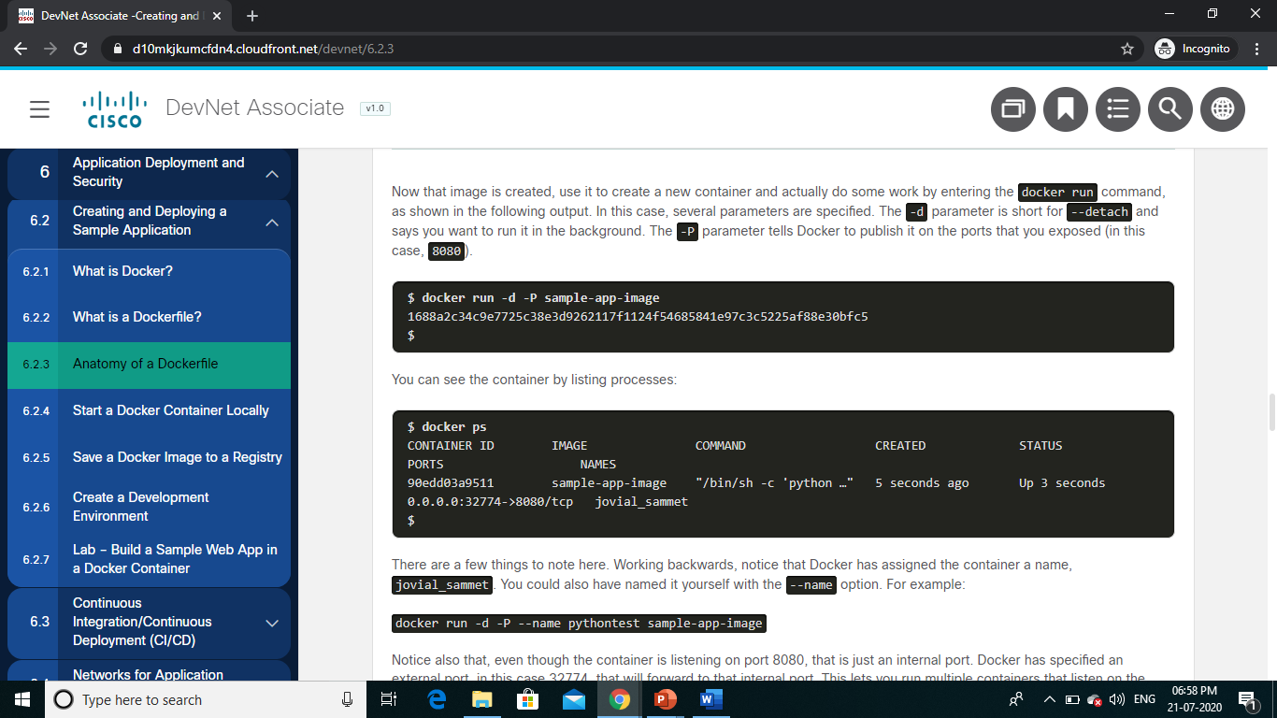
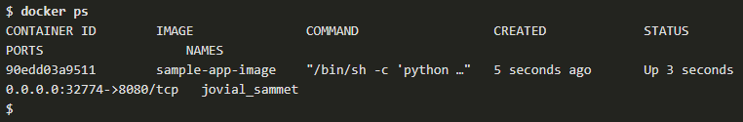
Creating and Deploying a Sample Application
Start a Docker Container Locally
After building the image using dockerfile, create a new container and do some work by entering the docker run command.
The -d parameter is short for –detach and indicates that the image should run in the background.
The -P parameter tells Docker to publish it on the port that was exposed.
Notice the container’s listing processes:
Notes:
6 – Application Deployment and Security
6.2 – Creating and Deploying a Sample Application
6.2.4 – Start a Docker Container Locally

Slide 33
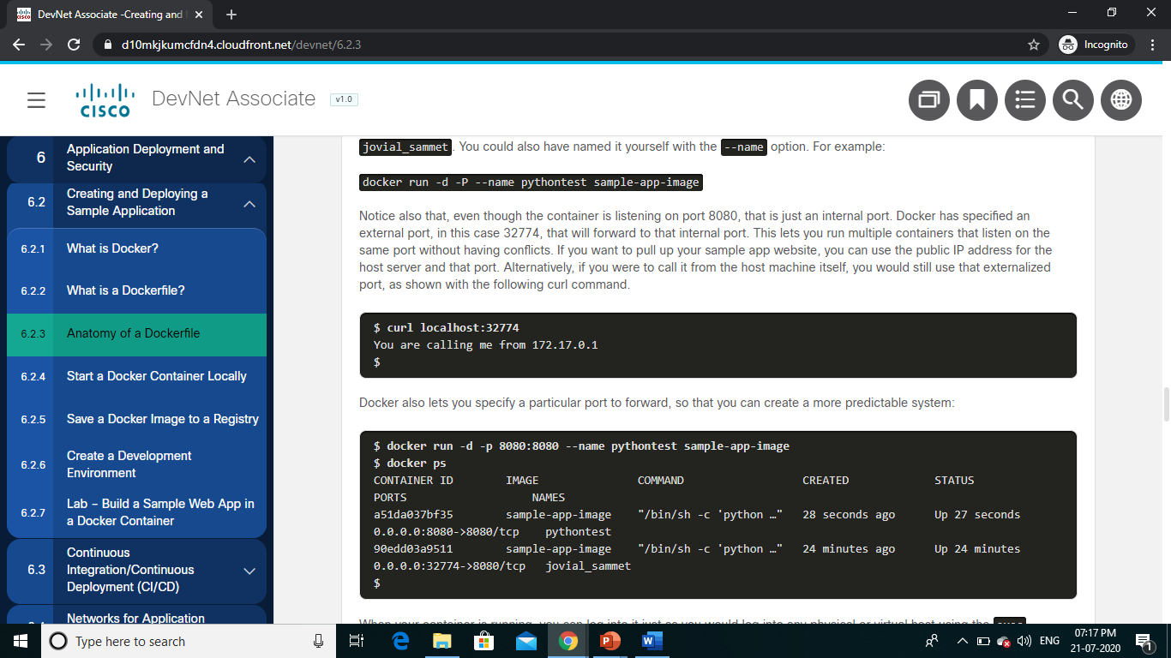
Creating and Deploying a Sample Application Start a Docker Container Locally (Contd.)
Notice that Docker has assigned the container a name as jovial_sammet. Naming is also done by with the --name option.
Even though the container is listening on port 80, it is just an internal port. Docker has specified an external port as 32774, which will forward to the internal port.
This lets you run multiple containers which listen on the same port without having conflicts.
To pull up the sample app website, use the public IP address for the host server and that port is used.
Notes:
6 – Application Deployment and Security
6.2 – Creating and Deploying a Sample Application
6.2.4 – Start a Docker Container Locally

Slide 34
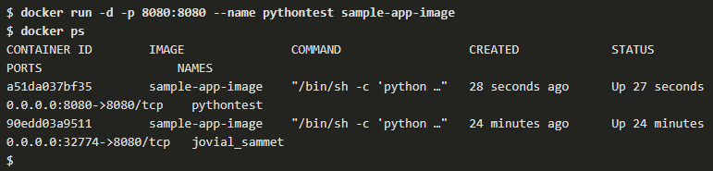
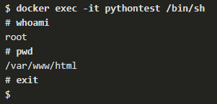
Creating and Deploying a Sample Application Start a Docker Container Locally (Contd.)
Docker also allows to specify a particular port to forward, so that a more predictable system can be created.
When the container is running, logging into it activity can be executed using the exec command.
Notes:
6 – Application Deployment and Security
6.2 – Creating and Deploying a Sample Application
6.2.4 – Start a Docker Container Locally

Slide 35
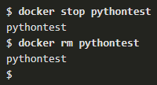
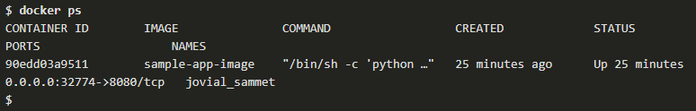
Creating and Deploying a Sample Application
Start a Docker Container Locally (Contd.)
To stop and remove a running container, call it by its name:
Notice the running processes again and the running container has been removed.
Notes:
6 – Application Deployment and Security
6.2 – Creating and Deploying a Sample Application
6.2.4 – Start a Docker Container Locally

Slide 36
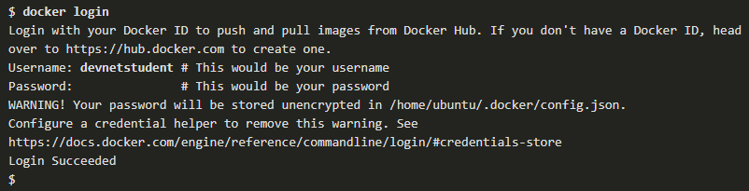
Creating and Deploying a Sample Application
Save a Docker Image to a Registry
To make the image available for users, store it in an image registry.
By default, Docker uses the Docker Hub registry, but users can create their own registry too. To start the process:
Log in to the registry.
Notes:
6 – Application Deployment and Security
6.2 – Creating and Deploying a Sample Application
6.2.5 – Save a Docker Image to a Registry

Slide 37
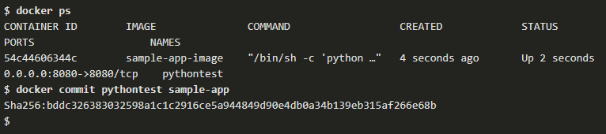
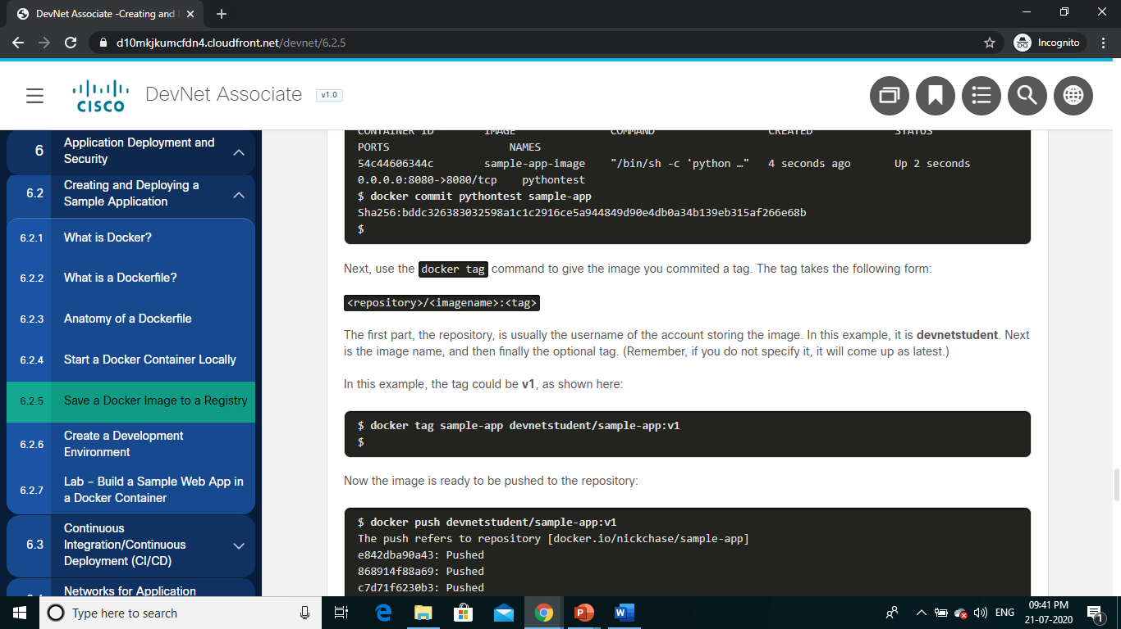
Creating and Deploying a Sample Application Save a Docker Image to a Registry (Contd.)
Commit the running container with the docker commit command.
Use the docker tag command to give the image the tag which was committed.
The first part, the repository, is usually the username of the account storing the image. Next is the image name, and then finally the optional tag.
Notes:
6 – Application Deployment and Security
6.2 – Creating and Deploying a Sample Application
6.2.5 – Save a Docker Image to a Registry

Slide 38
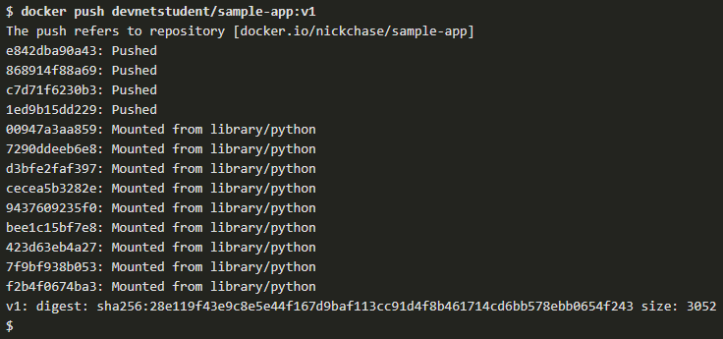
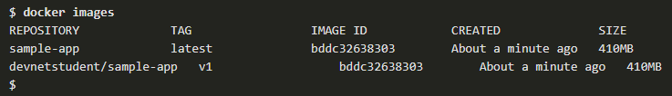
Creating and Deploying a Sample Application Save a Docker Image to a Registry (Contd.)
Now the image is ready to be pushed to the repository.
Notice that the new image is stored locally.
Notes:
6 – Application Deployment and Security
6.2 – Creating and Deploying a Sample Application
6.2.5 – Save a Docker Image to a Registry

Slide 39
Creating and Deploying a Sample Application Create a Development Environment
The development environment is meant to be convenient to the developer. It only needs to match the production environment where it is relevant.
A development environment can consist of any number of tools from Integrated Development Environments (IDEs) to databases to object storage such as Eclipse to databases to object storage. The important part here is that it has to be comfortable for the developer.
Notes:
6 – Application Deployment and Security
6.2 – Creating and Deploying a Sample Application
6.2.6 – Create a Development Environment

Slide 40
Creating and Deploying a Sample Application Lab – Build a Sample Web App in a Docker Container
In this lab, you will complete the following objectives:
Part 1: Launch the DEVASC VM
Part 2: Create a Simple Bash Script
Part 3: Create a Sample Web App
Part 4: Configure the Web App to Use Website Files
Part 5: Create a Bash Script to Build and Run a Docker Container
Part 6: Build, Run, and Verify the Docker Container
Notes:
6 – Application Deployment and Security
6.2 – Creating and Deploying a Sample Application
6.2.7 – Lab – Build a Sample Web App in a Docker Container

Slide 41
6.3 Continuous Integration/Continuous Deployment (CI/CD)
Notes:
Source:
6 – Application Deployment and Security
6.3 – Continuous Integration/Continuous Deployment (CI/CD)
In-Session Activities / Explanations:
Time: 20 min
Instructor Notes:
Introduce the topic and discuss the concept of Continuous Integration/Continuous Deployment (CI/CD).
Discuss the benefits of CI and CD.
Discuss the steps to build job for Jenkins and build a pipeline in Jenkins with the help of examples.
By the end of the topic, encourage the learners to perform the Hands-on Lab.
Key Points: Continuous Integration, Continuous Deployment, Rolling upgrade, Canary pipeline, Blue-green deployment.

Slide 42
Continuous Integration/Continuous Deployment (CI/CD) Introduction to CI/CD
Continuous Integration/Continuous Deployment (CI/CD) is a philosophy for software deployment that figures prominently in the field of DevOps.
DevOps is about communication and making certain all members of the team are working together to ensure smooth operation.
Notes:
6 – Application Deployment and Security
6.3 – Continuous Integration/Continuous Deployment (CI/CD)
6.3.1 – Introduction to CI/CD

Slide 43
Continuous Integration/Continuous Deployment (CI/CD)
Continuous Integration
Continuous Integration enables the developers on the project to continually merge the changes with the main branch of the existing application.
The Continuous Integration process provides a number of additional benefits:
Code compilation
Unit test execution
Static code analysis
Integration testing
Packaging and versioning
Publishing the version package to Docker Hub or other package repositories
Notes:
6 – Application Deployment and Security
6.3 – Continuous Integration/Continuous Deployment (CI/CD)
6.3.2 – Continuous Integration

Slide 44
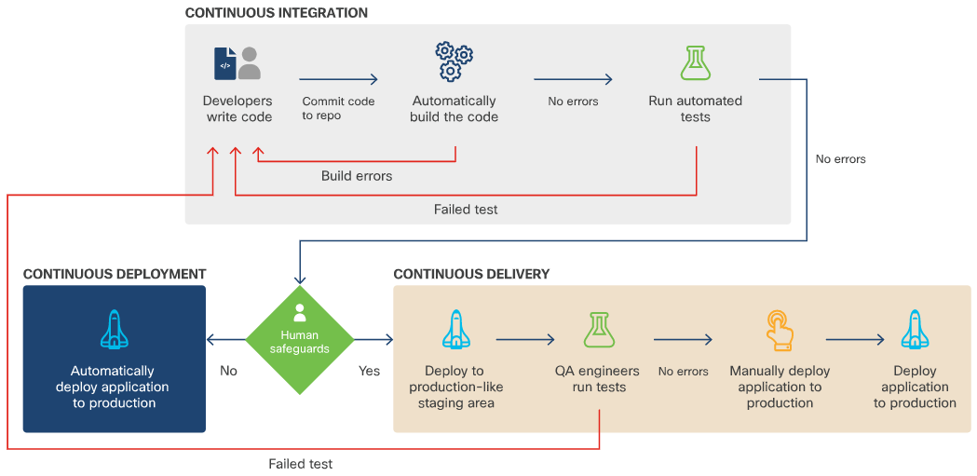
Continuous Integration/Continuous Deployment (CI/CD) Continuous Integration (Contd.)
Continuous Delivery
It is the process of developing in short sprints so that the code is always in a deployable state. It involves the following steps:
Step 1: Start with the version artifact created as part of the CI process.
Step 2: Automatically deploy the candidate version on staging.
Step 3: Run gating tests identified by the team or organization.
Step 4: If all gating tests pass, tag this build as suitable for production.
Notes:
6 – Application Deployment and Security
6.3 – Continuous Integration/Continuous Deployment (CI/CD)
6.3.2 – Continuous Integration

Slide 45
Continuous Integration/Continuous Deployment (CI/CD) Continuous Integration (Contd.)
Continuous Deployment
Continuous Deployment is the ultimate expression of CI/CD.
It is a special type of Continuous Delivery in which, every version of software that is marked as ready for production gets deployed.
Preventing impact to users
In order to avoid impacting users, or limit the impact, these deployment strategies can be used:
Rolling upgrade: The changes are periodically rolled out in such a way that they don't impact current users, and nobody should have to reinstall the software.
Canary pipeline: The new version is rolled out to a subset of users. If these users experience problems, the changes can be easily rolled back. If these users don't experience problems, the changes are rolled out to the rest of production.
Blue-green deployment: An entirely new environment (Blue) is created with the new code on it, but the old environment (Green) is held in reserve.
Notes:
6 – Application Deployment and Security
6.3 – Continuous Integration/Continuous Deployment (CI/CD)
6.3.2 – Continuous Integration

Slide 46
Continuous Integration/Continuous Deployment (CI/CD) CI/CD Benefits
The benefits of using CI/CD for development include:
Integration with agile methodologies
Shorter Mean Time To Resolution (MTTR)
Automated deployment
Less disruptive feature releases
Improved quality
Improved time to market
Notes:
6 – Application Deployment and Security
6.3 – Continuous Integration/Continuous Deployment (CI/CD)
6.3.3 – CI/CD Benefits

Slide 47
Continuous Integration/Continuous Deployment (CI/CD) Example Build Job for Jenkins
Deployment pipelines are normally created with a build tool such as Jenkins. These pipelines can handle tasks such as gathering and compiling source code, testing, and compiling artifacts such as tar files or other packages.
Example build job for Jenkins
The fundamental unit of Jenkins is the project, also known as the job. Jobs are created to do all sorts of things, from retrieving code from a source code management repo to building an application using a script or build tool, to packaging it up and running it on a server.
Notes:
6 – Application Deployment and Security
6.3 – Continuous Integration/Continuous Deployment (CI/CD)
6.3.4 – Example Build Job for Jenkins

Slide 48
Continuous Integration/Continuous Deployment (CI/CD) Example Build Job for Jenkins (Contd.)
To create a simple job that retrieves a version of the sample application from GitHub and runs the build script, perform the steps listed below:
Step 1: Create a New Item in the Jenkins interface by clicking the "create new jobs" link on the welcome page.
Step 2: Enter a name, choose Freestyle project (so that you have the most flexibility) and click OK.
Step 3: Scroll down to Source Code Management and select Git, then enter a GitHub repository URL for the Repository URL.
Step 4: Scroll down to Build and click Add Build Step. Choose Execute shell.
Step 5: In the Command box, add the command: buildscript.sh
Step 6: On the left-hand side, click Build Now to start the job.
Step 7: Move your mouse over the build number to get a pulldown menu that includes a link to the Console Output.
Notes:
6 – Application Deployment and Security
6.3 – Continuous Integration/Continuous Deployment (CI/CD)
6.3.4 – Example Build Job for Jenkins

Slide 49
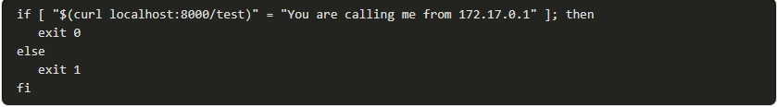
Continuous Integration/Continuous Deployment (CI/CD) Example Build Job for Jenkins (Contd.)
To create a second job that tests the build to ensure that it is working properly, perform the following steps:
Step 1: Click the Jenkins link and New Item to start a new job, then create another Freestyle job called TestAppJob.
Step 2: This time, leave the Source Code Management as None. But there is an option to set a Build Trigger so that this job runs right after the previous job, BuildAppJob.
Step 3: Scroll down and once again add a Build Step of Execute shell script.
Step 4: Add the following script as the command, using the IP address of an example Jenkins server and check to see if a condition is returned as true.
Notes:
6 – Application Deployment and Security
6.3 – Continuous Integration/Continuous Deployment (CI/CD)
6.3.4 – Example Build Job for Jenkins

Slide 50
Continuous Integration/Continuous Deployment (CI/CD) Lab – Build a CI/CD Pipeline Using Jenkins
In this lab, you will complete the following objectives:
Part 1: Launch the DEVASC VM
Part 2: Commit the Sample App to Git
Part 3: Modify the Sample App and Push Changes to Git
Part 4: Download and Run the Jenkins Docker Image
Part 5: Configure Jenkins
Part 6: Use Jenkins to Run a Build of Your App
Part 7: Use Jenkins to Test a Build
Part 8: Create a Pipeline in Jenkins
Notes:
6 – Application Deployment and Security
6.3 – Continuous Integration/Continuous Deployment (CI/CD)
6.3.6 – Lab – Build a CI/CD Pipeline Using Jenkins

Slide 51
6.4 Networks for Application Development and Security
Notes:
Source:
6 – Application Deployment and Security
6.4 – Networks for Application Development and Security
In-Session Activities / Explanations:
Time: 7 min
Instructor Notes:
Introduce the topic and discuss the concepts of firewall, load balancers, DNS, reverse proxies.
Key Points:
Firewalls, Load balancers, DNS, Reverse proxies

Slide 52
Networks for Application Development and Security Introduction
Networking accounts for all but the simplest of use cases such as cloud and container deployments.
Some of the applications which needs to be considered for cloud deployment are given below:
Firewalls
Load balancers
DNS
Reverse proxies
Notes:
6 – Application Deployment and Security
6.4 – Networks for Application Development and Security
6.4.1 – Introduction

Slide 53
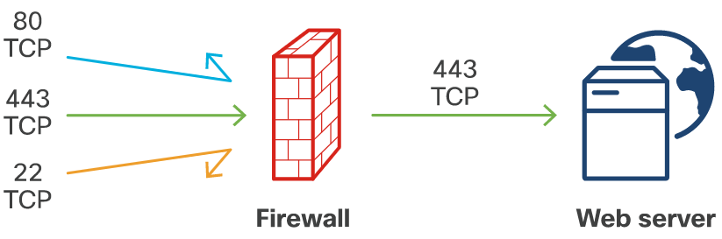
Networks for Application Development and Security Firewall
Firewalls are a computer’s most basic defense against unauthorized access by individuals or applications. They can take any number of forms, from a dedicated hardware device to a setting within an individual computer’s operating system.
At its most basic level, a firewall accepts or rejects packets based on the IP addresses and ports to which they're addressed.
Firewalls can be set up with specific “rules”, which are layered on top of each other.
A firewall can allow some connections and reject others.
Notes:
6 – Application Deployment and Security
6.4 – Networks for Application Development and Security
6.4.2 – Firewall

Slide 54
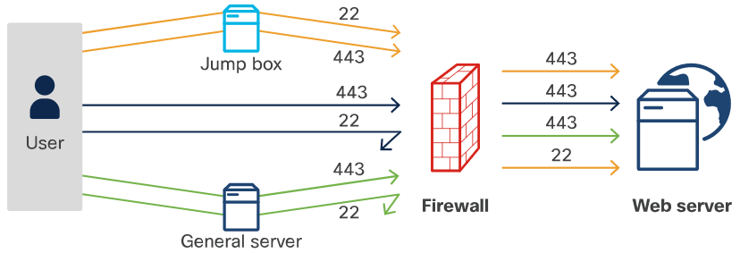
Networks for Application Development and Security Firewall (Contd.)
In some cases, you might set up your systems so that logins to sensitive systems can only come from a single machine. This is called a “jump box”.
A jump box can be used to provide additional access while still providing an additional layer of security. It sets up the systems so that logins can only come from a single machine and everyone must log into that server first, then log into the target machine from there.
Notes:
6 – Application Deployment and Security
6.4 – Networks for Application Development and Security
6.4.2 – Firewall

Slide 55
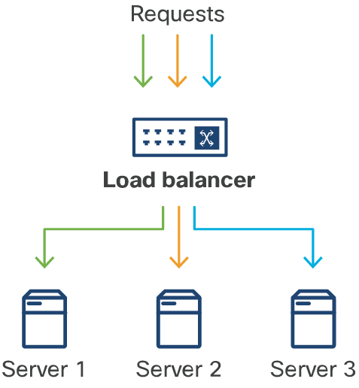
Networks for Application Development and Security Load Balancer
A load balancer takes requests and balances them by spreading them out among multiple servers.
A load balancer parcels out requests to different servers.
Load balancers makes their decisions on which servers should get a particular request in a few different ways.
Notes:
6 – Application Deployment and Security
6.4 – Networks for Application Development and Security
6.4.3 – Load Balancer

Slide 56
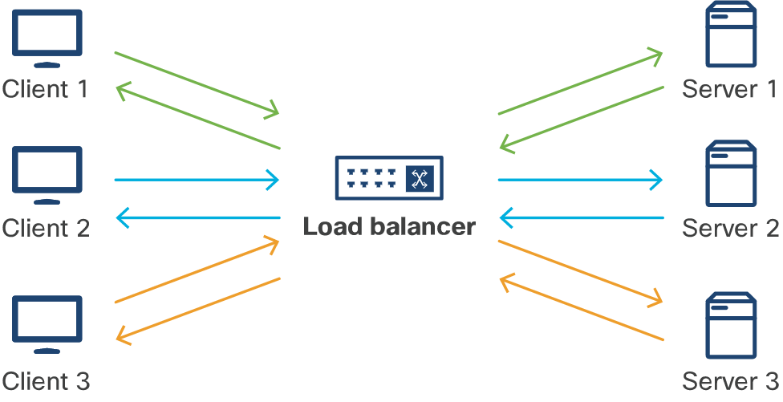
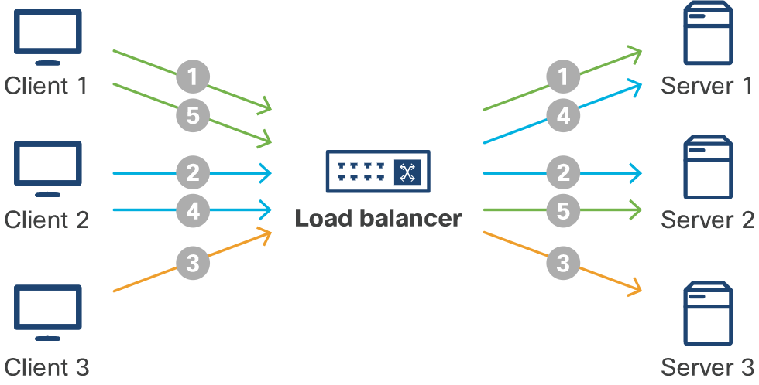
Networks for Application Development and Security Load Balancer (Contd.)
Persistent sessions - If an application requires a persistent session, a user needs to be logged in and the load balancer will send requests to the server handling the session.
Round robin - With round robin load balancing, the server sends each request to the next server on the list.
Notes:
6 – Application Deployment and Security
6.4 – Networks for Application Development and Security
6.4.3 – Load Balancer

Slide 57
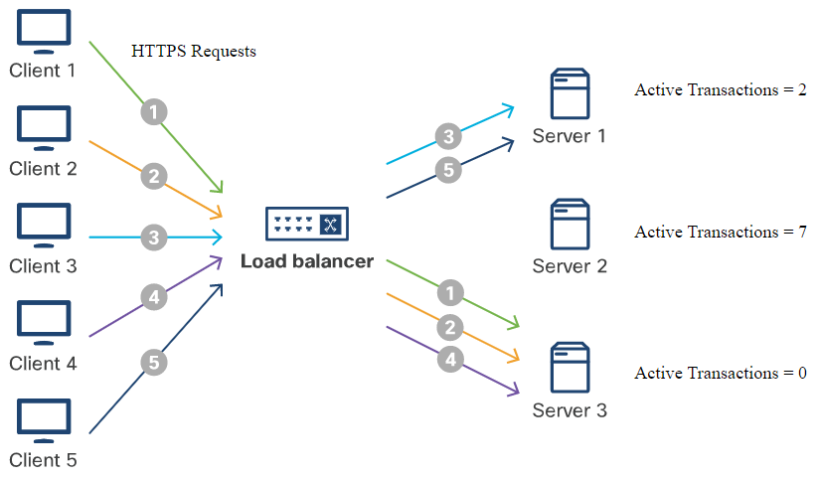
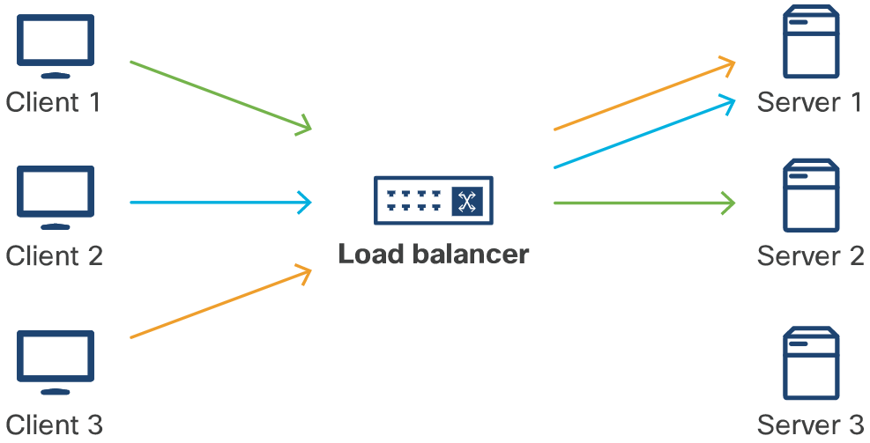
Networks for Application Development and Security Load Balancer (Contd.)
Least connections - The load balancer sends request to the server that is the least busy - the least number of active connections.
IP Hash - With this algorithm, The load balancer makes a decision based on a hash (an encoded value based on the IP address of the request).
Notes:
6 – Application Deployment and Security
6.4 – Networks for Application Development and Security
6.4.3 – Load Balancer

Slide 58
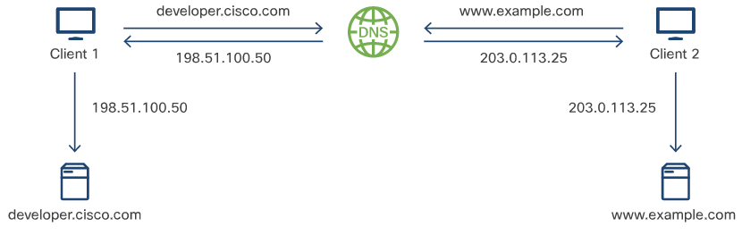
Networks for Application Development and Security DNS
Domain Name System (DNS) provides a way for the servers on the internet to translate human-readable names into machine-routable IP addresses. These IP addresses are necessary to actually navigate the internet.
DNS translates hostnames into (made-up) IP addresses.
Notes:
6 – Application Deployment and Security
6.4 – Networks for Application Development and Security
6.4.4 – DNS

Slide 59
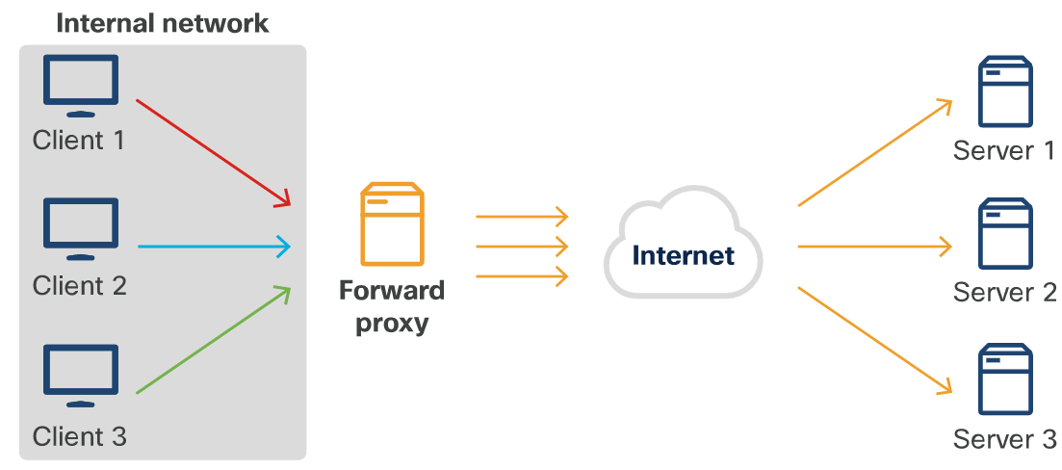
Networks for Application Development and Security Reverse Proxy
A reverse proxy is similar to a regular proxy, however, while a regular proxy works to make requests from multiple computers look like they all come from the same client, a reverse proxy works to make sure responses look like they all come from the same server.
A reverse proxy can evaluate traffic and act accordingly. In this way, it is similar to, and can be used as, a firewall or a load balancer.
Notes:
6 – Application Deployment and Security
6.4 – Networks for Application Development and Security
6.4.5 – Reverse Proxy

Slide 60
6.5 Securing Applications
Notes:
Source:
6 – Application Deployment and Security
6.5 - Securing Applications
In-Session Activities / Explanations:
Time: 45 min
Instructor Notes:
Start by mentioning that security is a major issue in today’s world. Build further context by mentioning that this part of the module focuses on some of the issues involved in securing both data and an application.
Explain how to secure the data.
Discuss SQL Injection and how to prevent and detect it.
Describe the various ways of securing the applications.
Explain Cross-Site Scripting (XSS), Cross-Site Request Forgery (CSRF) and the OWASP Top Ten.
Ensure that the learners know of the evolution of password systems and the techniques for cracking the password.
By the end of the topic, encourage the learners to perform the Hands-on Lab.
Key Points: Hash, SQL injection, Cross-Site Scripting (XSS), Cross-Site Request Forgery (CSRF), OWASP Top Ten, password cracking.

Slide 61
Securing Applications Securing the Data
Best practices for storing encrypted data
Data breaches occur when data is stored but not protected. When it comes to protecting data at rest, there are a few things to consider.
Encrypting data
Data encryption ensures that when an unauthorized access is gained into the system, the data is not visible in its actual form. There are two methods for encrypting data:
One-way encryption | Two-way encryption
One way encryption is simpler, in that you can easily create an encrypted value without necessarily using a specific key, but you cannot unencrypt it. You would use that for information you do not need to retrieve, just need to compare, such as passwords. | In Two-way encryption, you encrypt the data using a key, and then you can use that key (or a variation on it) to decrypt the data to get it back in plaintext. You would use this for information you would need to access in its original form, such as medical records or social security numbers.
Notes:
6 – Application Deployment and Security
6.5 – Securing Applications
6.5.1 – Securing the Data

Slide 62
Securing Applications Securing the Data (Contd.)
Software vulnerabilities
Most developers are not experts in security and can accidentally code security vulnerabilities into the application. Ensure that someone in the organization is responsible for keeping up with the latest vulnerabilities and patching them as appropriate.
Storing too much data
Unless the data is needed for an essential function, don't store it.
Storing data in the cloud
Remember that when storing data in the cloud, it is stored in someone else’s computer. Make sure that your cloud data is encrypted or otherwise protected.
Roaming devices
Apps are increasingly on devices that even more portable than laptops, such as tablets and especially mobile phones. They are simply easier to lose. Be sure you are not leaving your data vulnerable by encrypting it whenever possible.
Notes:
6 – Application Deployment and Security
6.5 – Securing Applications
6.5.1 – Securing the Data

Slide 63
Securing Applications Securing the Data (Contd.)
Best practices for transporting data
Data is also vulnerable when it is being transmitted. The following can be used to prevent data vulnerability problems:
SSH - SSH provides authentication and encryption of messages between the source and target machines, making it difficult or impossible to snoop on the users' actions.
TLS - TLS provides message authentication and stronger ciphers than SSL.
VPN - A VPN keeps all application-related traffic inside the network, which acts as a proxy and encrypts all traffic to and from the user.
Notes:
6 – Application Deployment and Security
6.5 – Securing Applications
6.5.1 – Securing the Data

Slide 64
Securing Applications What is SQL Injection?
SQL injection is a code injection technique that is used to attack data-driven applications, in which malicious SQL statements are inserted into an entry field for execution.
SQL injection exploits a security vulnerability in an application's software. This attack allows attackers to spoof identity, tamper with existing data, allow the complete disclosure of all data on the system, destroy the data or make it otherwise unavailable, and become administrators of the database server.
SQL in Web Pages
SQL injection is one of the most common web hacking techniques. It is the placement of malicious code in SQL statements, via web page input.
It occurs when a user is asked for input, like username/userid, and instead the user gives an SQL statement that is unknowingly executed on the database.
Notes:
6 – Application Deployment and Security
6.5 – Securing Applications
6.5.2 – What is SQL Injection?

Slide 65

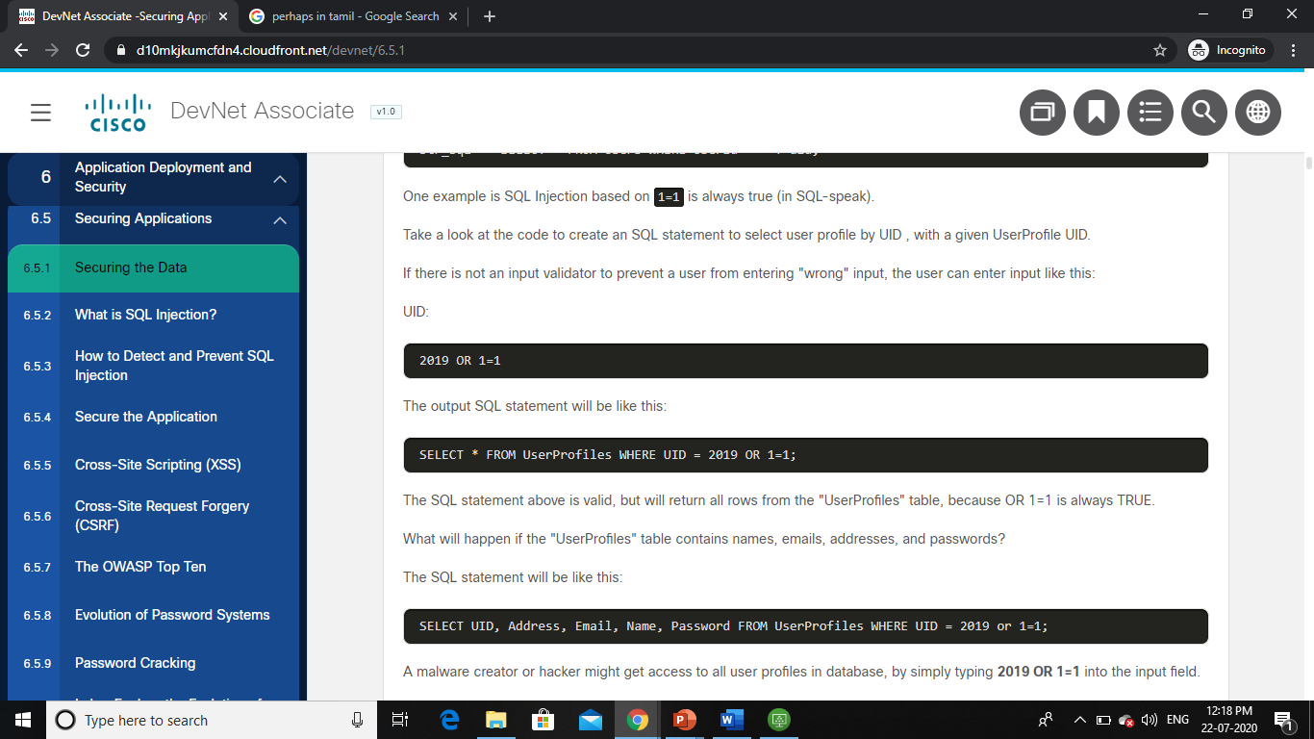
Securing Applications What is SQL Injection? (Contd.)
This example creates a SELECT statement by adding a variable uid to a select string. The variable is fetched from user input using request.args("uid").
SQL Injection based on 1=1 is always true. Create an SQL statement to select user profile by UID, with a given UserProfile UID.
If there is not input validator to prevent a user from entering "wrong" input, the user can enter some input as UID: 2019 OR 1=1
The output SQL statement will be:
Notes:
6 – Application Deployment and Security
6.5 – Securing Applications
6.5.2 – What is SQL Injection?

Slide 66
Securing Applications What is SQL Injection? (Contd.)
The SQL statement above is valid, but will return all rows from the UserProfiles table, because OR 1=1 is always TRUE.
If the UserProfiles table contains names, emails, addresses, and passwords, the SQL statement will be:
A malware creator or hacker might get access to all user profiles in database, by simply typing 2019 OR 1=1 into the input field.
Notes:
6 – Application Deployment and Security
6.5 – Securing Applications
6.5.2 – What is SQL Injection?

Slide 67
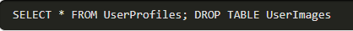
Securing Applications What is SQL Injection? (Contd.)
SQL Injection based on batched SQL statements
Most databases support batched SQL statements. A batch of SQL statements is a group of two or more SQL statements, separated by semicolons.
The SQL statement below will return all rows from the UserProfiles table, then delete the UserImages table.
Notes:
6 – Application Deployment and Security
6.5 – Securing Applications
6.5.2 – What is SQL Injection?

Slide 68
Securing Applications How to Detect and Prevent SQL Injection
SQL injection vulnerability exists because some developers do not care about data validation and security. There are tools that can help detect flaws and analyze code.
Open source tools: To detect a SQL injection attack easily, developers have created good detection engines such as SQLmap or SQLninja.
Source code analysis tools: Source code analysis tools, also known to as Static Application Security Testing (SAST) tools, are designed to analyze source code and/or compiled versions of code to help find security flaws such as buffer overflows, SQL Injection flaws, and others.
Work with a database firewall: Database firewalls detect SQL injections based on the number of invalid queries from a host, while there are OR and UNION blocks inside of request, or others.
Notes:
6 – Application Deployment and Security
6.5 – Securing Applications
6.5.3 – How to Detect and Prevent SQL Injection

Slide 69
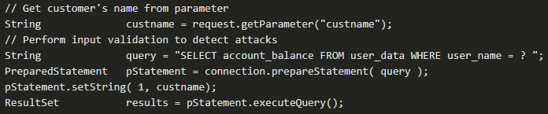
Securing Applications How to Detect and Prevent SQL Injection (Contd.)
Use prepared statements
Prepared statements with variable binding - also known as parameterized queries - are used by developers for writing database queries. Parameterized queries force the developer to first define all the SQL code, and then pass parameter to the query.
Prepared statements ensure that an attacker is not able to change the intent of a query, even if the SQL commands are inserted by an attacker.
Notes:
6 – Application Deployment and Security
6.5 – Securing Applications
6.5.3 – How to Detect and Prevent SQL Injection

Slide 70
Securing Applications How to Detect and Prevent SQL Injection (Contd.)
Use Stored Procedures
Stored procedures are not always safe from SQL injection.
The difference between prepared statements and stored procedures is that the SQL code for a stored procedure is defined and stored in the database itself, and then called from the application.
Both of these techniques have the same effectiveness in preventing SQL injection.
Whitelist Input Validation
Various parts of SQL queries are not legal locations for the use of bind variables.
In such situations, input validation or query redesign is the most appropriate defense.
If user parameter values are used for targeting different table names and column names, then the parameter values should be mapped to the legal/expected table or column names to ensure unvalidated user input does not end up in the query.
Notes:
6 – Application Deployment and Security
6.5 – Securing Applications
6.5.3 – How to Detect and Prevent SQL Injection

Slide 71
Securing Applications How to Detect and Prevent SQL Injection (Contd.)
Escaping all user-supplied input
This technique should only be used as a last resort when none of the techniques are feasible and involves escaping user input before putting it in a query.
The Escaping works in such a way that each DBMS supports one or more character escaping schemes specific to certain kinds of queries.
There are libraries and tools used for Input Escaping.
The ESAPI libraries make it easier for programmers to retrofit security into applications and serve as a solid foundation.
Notes:
6 – Application Deployment and Security
6.5 – Securing Applications
6.5.3 – How to Detect and Prevent SQL Injection

Slide 72
Securing Applications How to Detect and Prevent SQL Injection (Contd.)
Additional defenses
To provide defense in depth, these additional defenses can be adopted:
Least privilege: The privileges assigned to every database account should be minimized in order to reduce the potential damage of a successful SQL injection attack. Minimizing the privileges will reduce the unauthorized access attempts, even when an attacker is not trying to use SQL injection as part of their exploit.
Multiple database users: Web applications designers should avoid using the same owner/admin account in the web applications to connect to the database. Different DB users could be used for different web applications.
SQL views: SQL views is used to further increase the access detail by limiting read access to specific fields of a table or joins of tables.
Notes:
6 – Application Deployment and Security
6.5 – Securing Applications
6.5.3 – How to Detect and Prevent SQL Injection

Slide 73
Securing Applications Secure the Application
What is OWASP?
The Open Web Application Security Project (OWASP) is focused on providing education, tools, and other resources to help developers avoid security problems in web-based applications. Resources provided by OWASP include:
Tools | Code Projects | Documentation Projects
OWASP Zed Attack Proxy (ZAP) Dependency Check OWASP DefectDojo | OWASP ModSecurity Core Rule Set (CRS) OWASP CSRFGuard | OWASP Application Security Verification Standard OWASP Top Ten OWASP Cheat Sheet Series
Notes:
6 – Application Deployment and Security
6.5 – Securing Applications
6.5.4 – Secure the Application

Slide 74

Securing Applications Cross-Site Scripting (XSS)
Cross site scripting attacks happen when user-submitted content that has not been sanitized is displayed to other users.
The most obvious version of this exploit is where one user submits a comment that includes a script that performs a malicious action and anyone who views the comments page has that script executed on their machine.
Nowadays, the bigger problem is that the users are dealing with more than the data that is stored in the database, or “Stored XSS Attacks.” For example, consider this page, which displays content from a request parameter:
A hacker could trick someone into visiting the page with a link in an email that provides malicious code in a parameter:
Notes:
6 – Application Deployment and Security
6.5 – Securing Applications
6.5.5 – Cross-Site Scripting (XSS)

Slide 75

Securing Applications Cross-Site Scripting (XSS) (Contd.)
This link, which includes a url encoded version of the script, would result in an unsuspecting user seeing a page of:
This is called a Reflected XSS Attack. To prevent a reflected XSS attack, the main strategy is to sanitize content where possible, and if it cannot be sanitized, do not display it.
OWASP recommends never displaying untrusted content in the following locations:
Inside script tags
Inside comments
As part of attribute names
As part of tag names
In CSS (within style tags)
Notes:
6 – Application Deployment and Security
6.5 – Securing Applications
6.5.5 – Cross-Site Scripting (XSS)

Slide 76
Securing Applications Cross-Site Scripting (XSS) (Contd.)
The content can be displayed in some locations, if it is sanitized first. These locations include:
Content of an HTML tag
Value of an attribute
Variable within Javascript
Sanitizing content can be a complicated process to get right, as there are a wide variety of options an attacker has.
Notes:
6 – Application Deployment and Security
6.5 – Securing Applications
6.5.5 – Cross-Site Scripting (XSS)

Slide 77
Securing Applications Cross-Site Request Forgery (CSRF)
Another type of attack that shares some aspects of XSS attacks is Cross Site Request Forgery (CSRF), sometimes pronounced “Sea Surf.”
In both cases, the attacker intends for the user to execute the attacker’s code, usually without even knowing it.
The main difference is that CSRF attacks are typically aimed not at the target site, but rather at a different site, one into which the user has already authenticated.
An interesting aspect of CSRF is that the attacker never actually gets the results of the attack. They can only judge the results after the fact, and they have to be able to predict what the effects will be to take advantage of a successful attack.
Notes:
6 – Application Deployment and Security
6.5 – Securing Applications
6.5.6 – Cross-Site Request Forgery (CSRF)

Slide 78
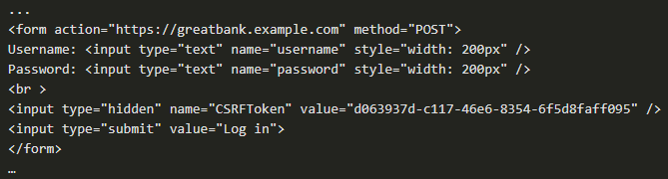
Securing Applications Cross-Site Request Forgery (CSRF) (Contd.)
One method to prevent CSRF attacks is to include a hidden token that must accompany any requests from the user.
That CSRFToken has to accompany every request from the user for it to be considered legitimate as it is impossible for the attacker to predict that token.
Notes:
6 – Application Deployment and Security
6.5 – Securing Applications
6.5.6 – Cross-Site Request Forgery (CSRF)

Slide 79
Securing Applications The OWASP Top Ten
OWASP list of attacks include:
Injection: This includes all sorts of injection attacks that can be prevented by using parameterized APIs, escaping user input, and by using LIMIT clauses.
Broken Authentication: This relates to multiple problems with user credentials. These attacks can be prevented by avoiding default passwords, using multi-factor authentication, and by using techniques like lengthening waiting periods after failed logins.
Sensitive Data Exposure: This refers to scenarios when attackers steal sensitive information. Such scenarios can be prevented by storing as little personal information as possible, and by using encryption.
XML External Entities (XXE): These are attacks made possible an XML feature that permits incorporating external information using entities, and can be prevented by disabling XML Entity and DTD processing, or by using JSON format.
Broken Access Control: This refers to the need to ensure that an application that enables users to circumvent existing authentication requirements should not be built and can be avoided by protecting all resources and functions on the server side.
Notes:
6 – Application Deployment and Security
6.5 – Securing Applications
6.5.7 – The OWASP Top Ten

Slide 80
Securing Applications The OWASP Top Ten (Contd.)
Security Misconfiguration: This refers to the need to ensure that the system itself is properly configured. Prevention of these types of problems requires careful, consistent hardening of systems and applications.
Cross-Site Scripting (XSS): This refers to the ability for an attacker to use the dynamic functions of a site to inject malicious content into the page. These attacks can be prevented by carefully considering where to include the untrusted content as well as sanitizing any untrusted content.
Insecure Deserialization: This describes issues that can occur if attackers can access, and potentially change, serialized versions of data and objects. To prevent such issues, do not accept serialized objects from untrusted sources.
Using Components with Known Vulnerabilities: Most of the core functions are probably been written and included in an existing software package, and it is probably open source. Many of the packages that are available also include publicly available exploits. To fix this, ensure that they are using only necessary features and secure packages.
Insufficient Logging and Monitoring: It is important to ensure that the logs are in a common format so that they can be easily consumed by reporting tools, and that they are auditable to detect tampering.
Notes:
6 – Application Deployment and Security
6.5 – Securing Applications
6.5.7 – The OWASP Top Ten

Slide 81
Securing Applications Evolution of Password Systems
Simple Plaintext Passwords
The first passwords were simple plaintext passwords that allowed multiple users using the same core processor to have unique privacy settings.
Plaintext is an insecure way of storing passwords. If the database was hacked, the user's passwords would be exposed to hackers directly.
Password Hashing
Storing passwords is risky and complex at the same time.
A simple approach to storing passwords is to create a table in the database that maps a username with a password.
The security strength and resilience of this model depends on password storage format which is cleartext.
Storing passwords in cleartext is the equivalent of writing them down in a piece of digital paper. If an attacker breaks into the database and steal the passwords table, the attacker could then access each user account.
Notes:
6 – Application Deployment and Security
6.5 – Securing Applications
6.5.8 – Evolution of Password Systems

Slide 82
Securing Applications Evolution of Password Systems (Contd.)
Hashing
Hashing is a more secure way to store a password in which it is transformed into data that cannot be converted back to the original password.
As stated by OWASP, hash functions used in cryptography have the following key properties:
It is easy and practical to compute the hash, but difficult or impossible to re-generate the original input if only the hash value is known.
It's difficult to create an initial input that would match a specific desired output.
Salted password
To guarantee the uniqueness of the passwords, increase their complexity, a salt, which is simply random data, is added to the input of a hash function.
Notes:
6 – Application Deployment and Security
6.5 – Securing Applications
6.5.8 – Evolution of Password Systems

Slide 83
Securing Applications Evolution of Password Systems (Contd.)
Using cryptographic hashing for more secure password storage
A critical property that makes hash functions suitable for password storage is that they are deterministic.
A deterministic function is a function that, given the same input, always produces the same output. This is vital for authentication because one needs to have the guarantee that a given password will always produce the same hash. Otherwise, it would be impossible to consistently verify user credentials with this technique.
Adding salt to password hashing
A salt is added to the hashing process to force hash uniqueness thereby increasing complexity without increasing user requirements, and mitigating password attacks such as rainbow tables.
The unique hash produced by adding the salt can protect against different attack vectors, while slowing down dictionary and brute-force attacks.
Notes:
6 – Application Deployment and Security
6.5 – Securing Applications
6.5.8 – Evolution of Password Systems

Slide 84
Securing Applications Evolution of Password Systems (Contd.)
Mitigating password attacks with a salt
To mitigate the damage that a rainbow table or a dictionary attack could do, salt the passwords.
According to OWASP Guidelines, a salt is a fixed-length cryptographically-strong random value that is added to the input of hash functions to create unique hashes for every input, regardless of whether the input is unique.
Let’s say that you have password devnet_password1 and the salt salt706173776f726473616c74a
You can salt that password by either appending or prepending the salt to it.
Notes:
6 – Application Deployment and Security
6.5 – Securing Applications
6.5.8 – Evolution of Password Systems

Slide 85
Securing Applications Evolution of Password Systems (Contd.)
Additional factors for authentication
Incorporating other authentication factors confuses the hackers who may have cracked the password. Some of these factors are as follows:
Single-factor authentication (SFA)
Single-factor authentication is the simplest form of authentication methods, using which, a person matches one credential to verify himself or herself online. The most popular example of this would be a password (credential) to a username.
SFA has its risks as Online sites can have users' passwords leaked by a hacker. A malicious user may guess the password as they know the user personally, or as they were able to find out certain things about the user.
A malicious user may also crack the password by using a bot to generate the right combination of letters/numbers to match the users' simple, secret identification method.
Notes:
6 – Application Deployment and Security
6.5 – Securing Applications
6.5.8 – Evolution of Password Systems

Slide 86
Securing Applications Evolution of Password Systems (Contd.)
Two-factor authentication (2FA)
Two-factor authentication uses the same password/username combination, but with the addition of being asked to verify the identity of the persons by using something owned by them only such as a mobile device.
Multi-factor authentication (MFA)
Multi-factor authentication (MFA) is a method of computer access control in which a user is only granted access after successfully presenting several separate pieces of evidence to an authentication mechanism.
At least two of the mentioned categories are required for MFA: knowledge; possession, and inherence.
2FA is just a type of MFA where you only need two pieces of evidence, two “factors”.
Notes:
6 – Application Deployment and Security
6.5 – Securing Applications
6.5.8 – Evolution of Password Systems

Slide 87
Securing Applications Password Cracking
The techniques for finding a password that allows entry is known as cracking the security intended by the password. The following are some of the techniques:
Password guessing
Password guessing is an online technique that involves attempting to authenticate a particular user to the system.
It may be detected by monitoring the failed login system logs.
Account lockouts are used to prevent an attacker from being able to simply guess the correct password by attempting a large number of potential passwords.
Dictionary attack
A dictionary attack is based on trying all the strings in a pre-arranged listing, derived from a list of words such as in a dictionary.
These succeed because many people have a tendency to choose short passwords that are ordinary words or common passwords.
Notes:
6 – Application Deployment and Security
6.5 – Securing Applications
6.5.9 – Password Cracking

Slide 88
Securing Applications Password Cracking (Contd.)
Pre-computed dictionary attack or rainbow table attack
It is possible to achieve a time/space tradeoff by pre-computing a list of hashes of dictionary words, and storing these in a database using the hash as the key.
Pre-computed dictionary attacks are effective when a large number of passwords are to be cracked.
Pre-computed dictionary attacks can be thwarted by the use of salt, a technique that forces the hash dictionary to be recomputed for each password sought, making pre-computation infeasible, provided the number of possible salt values is large enough.
Social engineering
Social engineering for password cracking involves a person convincing or tricking another person for providing access to the attacker.
Notes:
6 – Application Deployment and Security
6.5 – Securing Applications
6.5.9 – Password Cracking

Slide 89
Securing Applications Password Cracking (Contd.)
Six key principles of human influence
Reciprocity – Our social norms mean that we tend to return a favor when asked.
Commitment and consistency – When people commit, whether in person, in writing, or on a web site, they are more likely to honor that commitment in order to preserve their self-image.
Social proof – When people see someone else doing something, such as looking up, others will stop to do the same.
Authority – This authority principle means that attackers who seem to be authoritative or representing an authority figure are more likely to gain access.
Liking – Likable people are able to persuade others more effectively. People are easily persuaded by familiar people whom they like.
Scarcity – When people believe that something is limited in amount, people will act positively and quickly to pick up the desired item.
Notes:
6 – Application Deployment and Security
6.5 – Securing Applications
6.5.9 – Password Cracking

Slide 90
Securing Applications Password Cracking (Contd.)
There are four social engineering vectors, or lines of attack, that can take advantage of these influence principles.
Phishing means the person is fraudulently gaining information, especially through requests for financial information. Often the attempts look like a real web site or email, but link to a collector site instead.
Vishing stands for voice phishing, so it is associated with voice phone calls to gather private personal information for financial gain.
Smishing involves using SMS text messaging for both urgency and asking for a specific course of action, such as clicking a fake link or sending account information.
Impersonation involves in-person scenarios such as wearing a service provider uniform to gain inside access to a building or system.
Notes:
6 – Application Deployment and Security
6.5 – Securing Applications
6.5.9 – Password Cracking

Slide 91
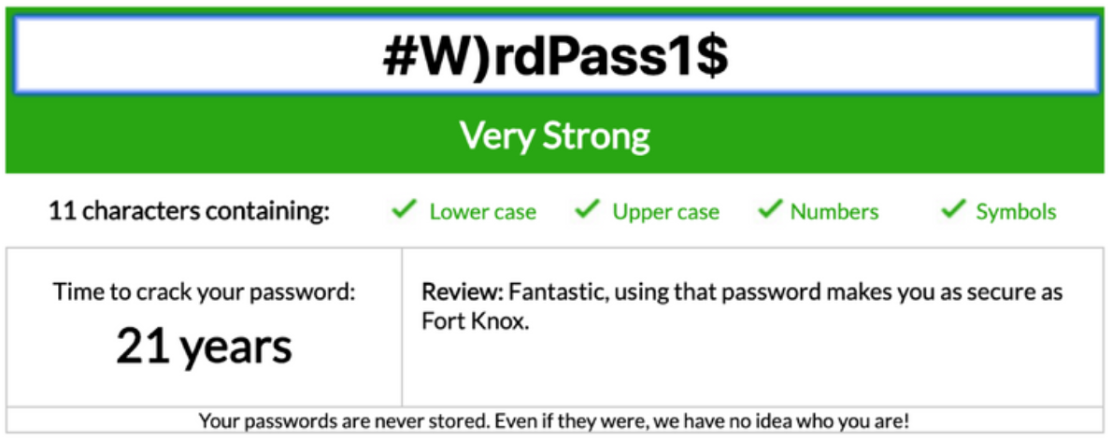
Securing Applications Password Cracking (Contd.)
Password strength - Password strength is the measure of a password’s efficiency to resist password cracking attacks. The strength of a password is determined by:
Length: This is the number of characters the password contains.
Complexity: This means it uses a combination of letters, numbers, and symbols.
Unpredictability: Something that can be guessed easily by an attacker.
Here, the password #W)rdPass1 has strength and it would take about 21 years to crack it.
Notes:
6 – Application Deployment and Security
6.5 – Securing Applications
6.5.9 – Password Cracking

Slide 92
Securing Applications Password Cracking (Contd.)
Password strength checkers and validation tools
The password strength validation tool is built in with password system to make sure the user's password is compatible with latest identity management guidelines.
Password manager is the tool to ensure the strength of the password.
Best practices
There are a few best practices to secure user login attempts. It includes notifying users of suspicious behavior, limiting the number of password and username login attempts.
Notes:
6 – Application Deployment and Security
6.5 – Securing Applications
6.5.9 – Password Cracking

Slide 93
Securing Applications Password Cracking (Contd.)
NIST Digital Identity Guidelines
Here's a brief summary of the NIST 800-63B Digital Identity Guidelines:
8-character minimum when a human sets it and 6-character minimum when set by system/service.
Support at least 64 characters maximum length and all ASCII characters.
Truncation of the password shall not be performed when processed.
Check chosen password with known password dictionaries.
Allow at least 10 password attempts before lockout.
No complexity requirements, password expiration period, password hints.
No SMS for two-factor authentication, knowledge-based authentication.
Notes:
6 – Application Deployment and Security
6.5 – Securing Applications
6.5.9 – Password Cracking

Slide 94
Securing Applications Lab – Explore the Evolution of Password Methods
In this lab, you will complete the following objectives:
Part 1: Launch the DEVASC VM
Part 2: Explore Python Code Storing Passwords in Plain Text
Part 3: Explore Python Code Storing Passwords Using a Hash
Notes:
6 – Application Deployment and Security
6.5 – Securing Applications
6.5.10 – Lab – Explore the Evolution of Password Methods

Slide 95
6.6 Summary: Application Deployment and Security
Notes:
Source:
6 – Application Deployment and Security
6.6 – Summary: Application Deployment and Security
In-Session Activities / Explanations:
Time: 5 min
Instructor Notes:
Read out the summary points mentioned on the slide.
Discuss the same with the participants.
Ask if they have any questions or doubts.
At the end, ask the students to take the quiz.
Key Points: NA

Slide 96
Summary: Application Deployment and Security
What Did I Learn in this Module?
Understanding Deployment Choices with Different Models
Large organizations use a four-tier structure: development, testing, staging, and production.
The options to deploy the software are bare metal, virtual machines, containers, and serverless computing.
On-premises means any system that’s within the confines of your building.
Clouds provide self-service access to computing resources, such as VMs, containers, and even bare metal.
The advantage of a private cloud is that the user has complete control over where it is located.
A public cloud is essentially the same as a private cloud, but it is managed by a public cloud provider.
Hybrid cloud is used to bridge a private cloud and a public cloud within a single application.
An edge cloud moves computing closer to where it’s needed.
Notes:
6 – Application Deployment and Security
6.5 – Summary: Application Deployment and Security
6.6.1 – What Did I Learn in this Module?

Slide 97
Summary: Application Deployment and Security
What Did I Learn in this Module? (Contd.)
Creating and Deploying a Sample Application
A container is way of encapsulating everything needed to run the application, so that it can easily be deployed in a variety of environments.
Docker is a way of creating and running that container.
The development environment is meant to be convenient to the developer; it only needs to match the production environment
A development environment can consist of any number of tools, from IDEs to databases to object storage.
Notes:
6 – Application Deployment and Security
6.5 – Summary: Application Deployment and Security
6.6.1 – What Did I Learn in this Module?

Slide 98
Summary: Application Deployment and Security
What Did I Learn in this Module? (Contd.)
Continuous Integration/Continuous Deployment (CI/CD)
CI/CD is a philosophy for software deployment that figures prominently in the field of DevOps.
Continuous Integration all the developers on the project, continually merge your changes with the main branch of the existing application.
A deployment pipeline, can be created with a build tool such as Jenkins.
Networks for Application Development and Security
The applications you need to consider when it comes to cloud deployment include: Firewalls, Load balancers, DNS, and Reverse proxies.
At its most basic level, a firewall accepts or rejects packets based on the IP addresses and ports to which they're addressed.
Notes:
6 – Application Deployment and Security
6.5 – Summary: Application Deployment and Security
6.6.1 – What Did I Learn in this Module?

Slide 99
Summary: Application Deployment and Security
What Did I Learn in this Module? (Contd.)
Securing Applications
Securing data in two methods by encrypting data: one-way encryption, and two-way encryption.
SQL injection must exploit a security vulnerability in an application's software.
A more secure way to store a password is to transform it into data that cannot be converted back to the original password, known as hashing.
By cryptography password are made to be secure.
Notes:
6 – Application Deployment and Security
6.5 – Summary: Application Deployment and Security
6.6.1 – What Did I Learn in this Module?
6.6.2 - Module 6: Application Deployment and Security Quiz

Slide 100
Module 6 New Terms and Commands
Edge Clouds Private clouds Continuous integration Staging environment Over Committing | Docker Continuous Integration Jump box Canary Pipeline Whitelist input validation | Insecure deserialization Hashing Multi factor authentication Reciprocity OWASP
Notes:
6 – Application Deployment and Security
New Terms and Commands

